Slide 1

Database Systems

Slide 2
Group Members
Venkata Saketh Vellanki - 801254039
Chiranjeevi Venkata Siva Kumar Gorantla - 801259516
Dileep Kumar Komatineni - 801261197
Dedeepya Ramineni - 801254831

Slide 3
Project Overview
Food delivery services have become an indispensable part of our life. It’s critical for institutions to maintain track of orders placed. CampusEats database is all about the food delivery system. Each student is considered as a person similarly each staff member is considered as a person. A user first has to create an account for placing an order and ordering the food. All the accepting restaurants are registered in the database with their respective locations and users search for the restaurants and order the food. A delivery person will be associated with the order. Our database holds the record of each staff member. Students can work as drivers to deliver the food if they have a driving licence.

Slide 4
Business Rules
Only students are acceptable to be drivers.
Person types are limited to students, faculty, staff, and drivers.
Only one rating per order is permitted.
Cash, credit card, or direct deposit are all accepted modes of payment.
There is no limit to the number of order items that can be placed in a single order.
Offer types include a restaurant, delivery, referral, or application offers only.
Ratings are not mandatory.
An order can have both an overall and a restaurant rating, or both.
Persons who can order are limited to students, faculty, and/or staff.
Per individual, only one offer is valid.
Restaurant deals are only redeemable by students, instructors, employees, and drivers.
There is a limit of one social media handle per restaurant.
All of the locations must be on campus.

Slide 5
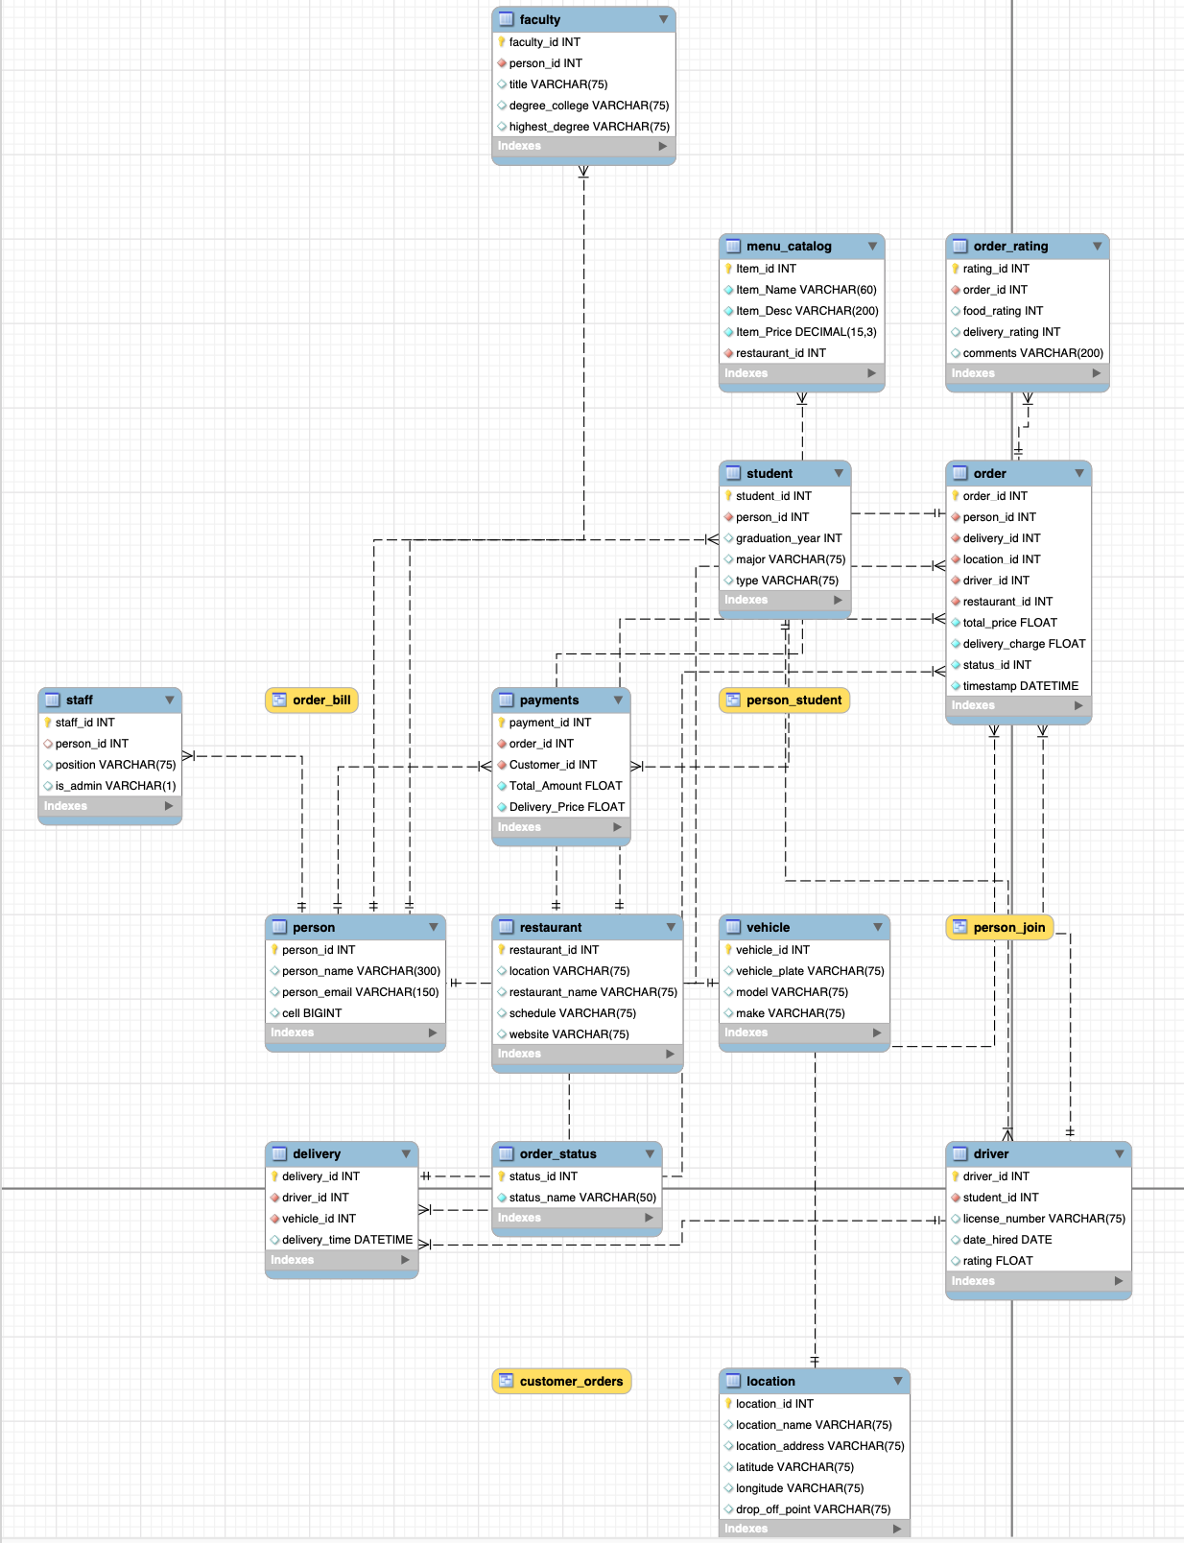
EERD Diagram

Slide 6
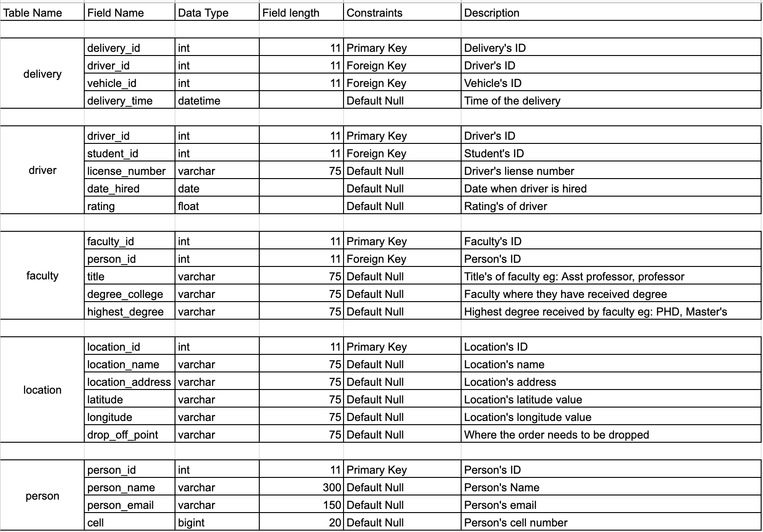
Data Dictionary

Slide 7
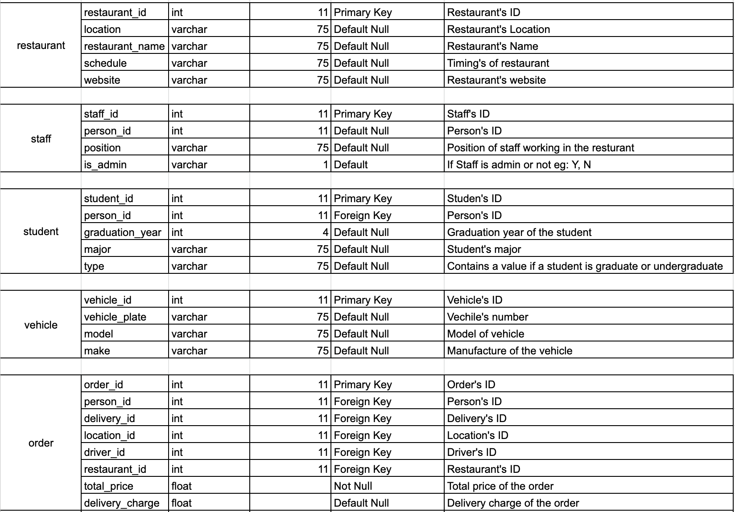
Data dictionary

Slide 8
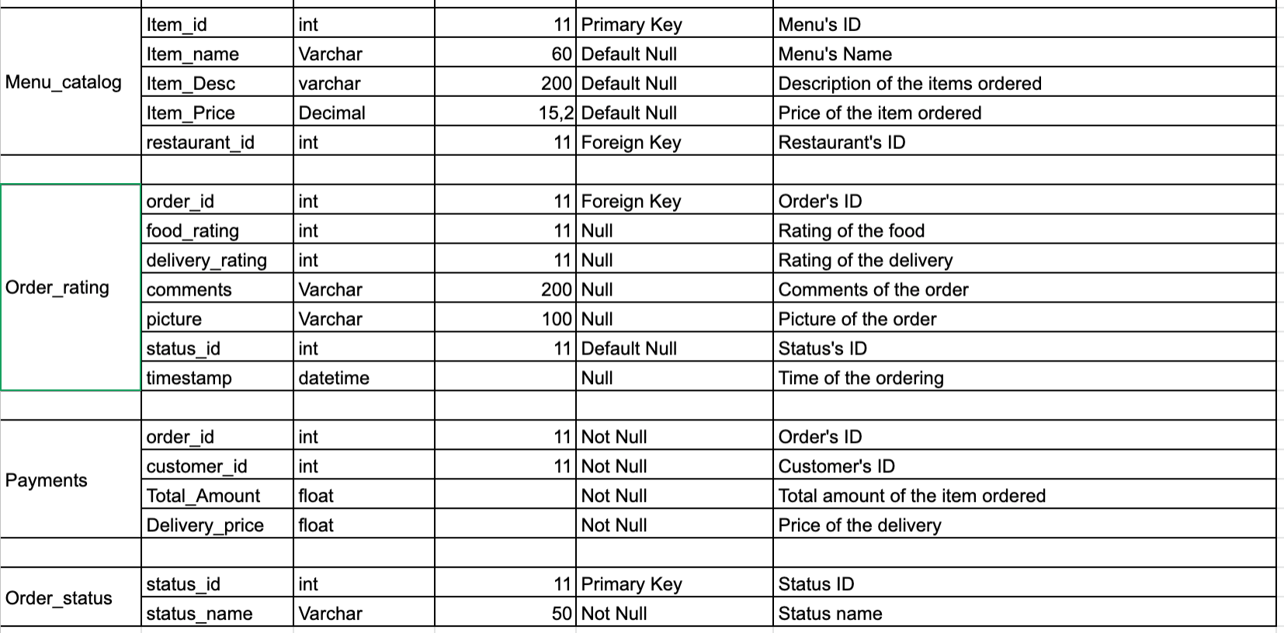
Data dictionary

Slide 9
Stored Procedure-1
USE `campus_eats_fall2020`;
DROP PROCEDURE IF EXISTS order_count;
DELIMITER //
CREATE PROCEDURE order_count(IN begin_year INT,IN final_year INT, OUT output_str varchar(100))
BEGIN
DECLARE number_of_orders Varchar(20);
SELECT count(*) into number_of_orders
FROM `order`
WHERE person_id in ( select person_id from student where graduation_year between begin_year and final_year);
IF number_of_orders < 0 THEN
SET output_str = CONCAT("The number of orders are 0");
ELSE
SET output_str = CONCAT("The number of orders are ", number_of_orders);
END IF;
END //
DELIMITER ;
CALL order_count(2015,2019,@output_str);
Select @output_str

Slide 10
Stored Procedure-2
USE campus_eats_fall2020;
DROP PROCEDURE IF EXISTS max_min_avg_rating_for_each_feature;
DELIMITER //
CREATE PROCEDURE max_min_avg_rating_for_each_feature (IN restaurant_id INT(50), OUT max_food INT, OUT min_food INT, OUT avg_food INT, OUT max_deli INT, OUT min_deli INT, OUT avg_deli INT)
BEGIN
SET max_food = 0;
SET min_food = 0;
SET avg_food = 0;
SET max_deli = 0;
SET min_deli = 0;
SET avg_deli = 0;
select max(food_rating)
into max_food
from order_rating where order_id
IN (select order_id from `order` where `order`.restaurant_id = 3);
select min(food_rating)
into min_food
from order_rating where order_id
IN (select order_id from `order` where `order`.restaurant_id = 5);

Slide 11
Stored Procedure-2
select avg(food_rating)
into avg_food
from order_rating where order_id
IN (select order_id from `order` where `order`.restaurant_id = 7);
select max(delivery_rating)
into max_deli
from order_rating where order_id
IN (select order_id from `order` where `order`.restaurant_id = 3);
select min(delivery_rating)
into min_deli
from order_rating where order_id
IN (select order_id from `order` where `order`.restaurant_id = 7)
select avg(delivery_rating)
into avg_deli
from order_rating where order_id
IN (select order_id from `order` where `order`.restaurant_id = 9);
END //
DELIMITER ;
CALL max_min_avg_rating_for_each_feature(2,@Max_Food_Rating,@Min_Food_Rating, @Avg_Food_Rating, @Max_Deli_Rating, @Min_Deli_Rating, @Avg_Deli_Rating);
SELECT @Max_Food_Rating, @Min_Food_Rating, @Avg_Food_Rating, @Max_Deli_Rating, @Min_Deli_Rating, @Avg_Deli_Rating ;

Slide 12
Indexes
CREATE TABLE IF NOT EXISTS `campus_eats_fall2020`.`order_rating` ( `rating_id` INT NOT NULL,
`order_id` INT NOT NULL,
`food_rating` INT NULL,
`delivery_rating` INT NULL,
`comments` VARCHAR(200) NULL,
PRIMARY KEY (`rating_id`),
INDEX `order_id_indx` (`order_id` ASC) VISIBLE, CONSTRAINT `order_id`
FOREIGN KEY (`order_id`)
REFERENCES `campus_eats_fall2020`.`order` (`order_id`))

Slide 13
Views
USE `campus_eats_fall2020;
CREATE OR REPLACE VIEW order_bill AS
SELECT DISTINCT person_id as customer_id,
ROUND(total_price + delivery_charge) AS order_cost
FROM campus_eats_fall2020.order
GROUP BY person_id;
select * from order_bill;

Slide 14
Functions
DROP FUNCTION IF EXISTS driver_expertise;
DELIMITER //
CREATE FUNCTION driver_expertise ( rating INT).
RETURNS varchar(150)
DETERMINISTIC
BEGIN
DECLARE rating_feedback varchar(150);
IF rating = 1 THEN
SET rating_feedback = "Bad driver";
ELSEIF rating = 2 THEN
SET rating_feedback = "Moderate driver";
ELSEIF rating = 3 THEN
SET rating_feedback = "Decent driver";
ELSEIF rating = 4 THEN
SET rating_feedback = "Great driver";
ELSEIF rating = 5 THEN
SET rating_feedback = "Excellent driver";
END IF;
RETURN rating_feedback;
END//
DELIMITER ;
select driver_id, driver_expertise(rating) from driver;

Slide 15
Thank you

